Slide 1
Branch4
BART Analytics

Slide 2
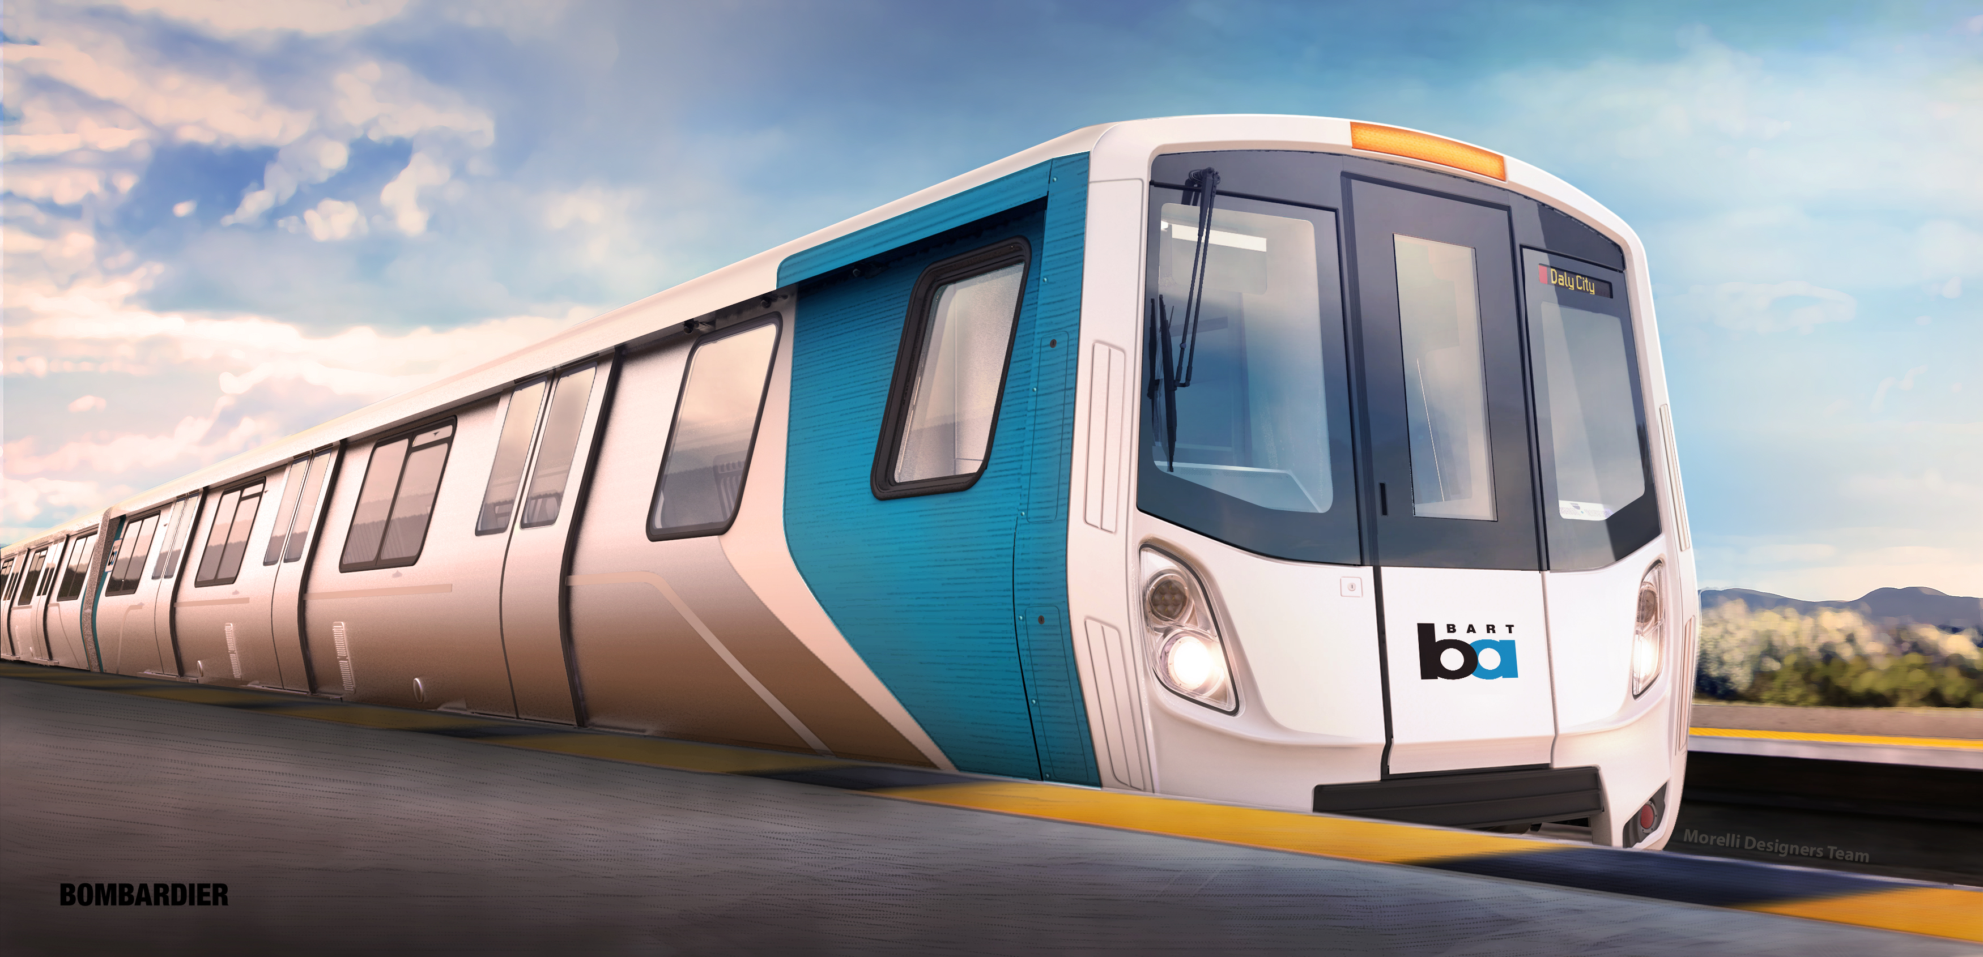
To ride or not to ride Bart?

Slide 3
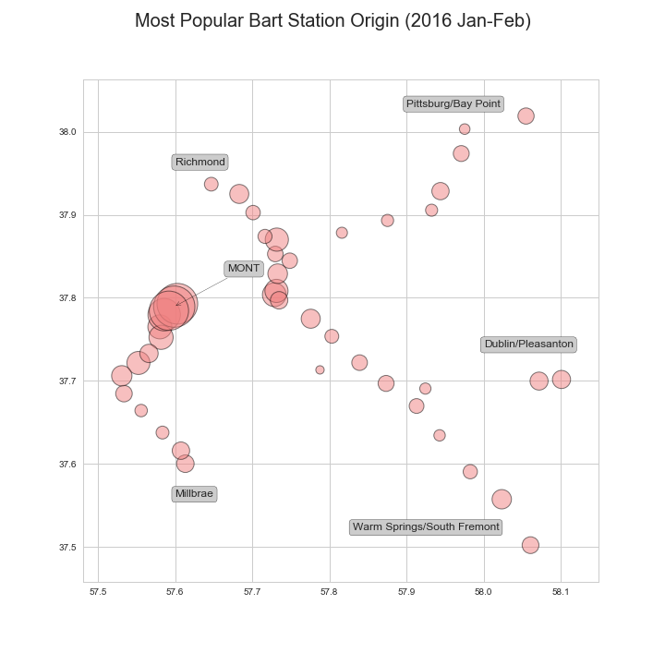
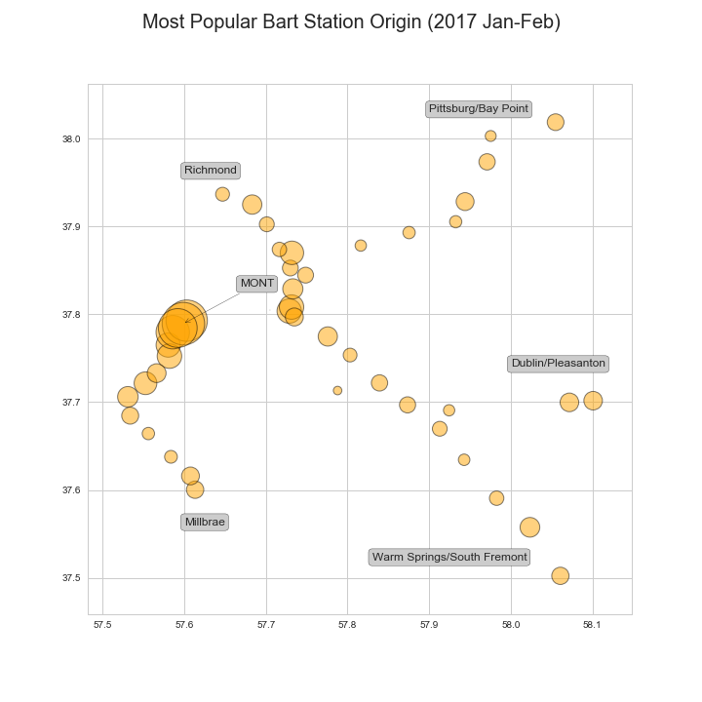
Super Bowl Impact– Origin station (Jan-Feb)

Slide 4
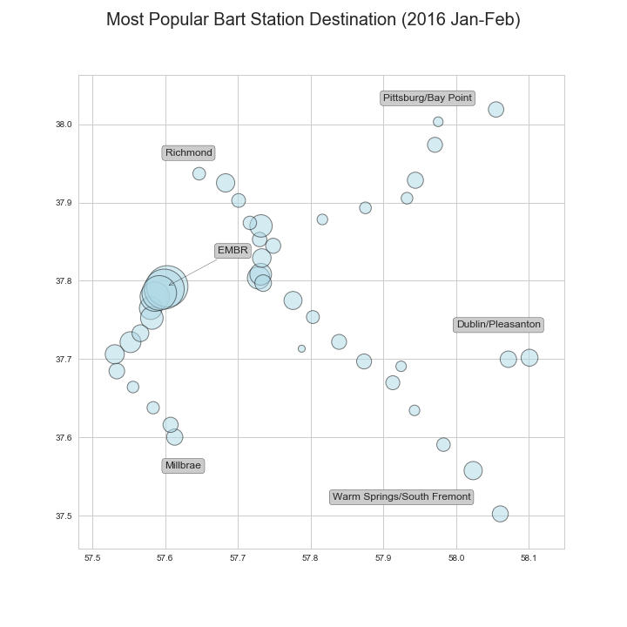
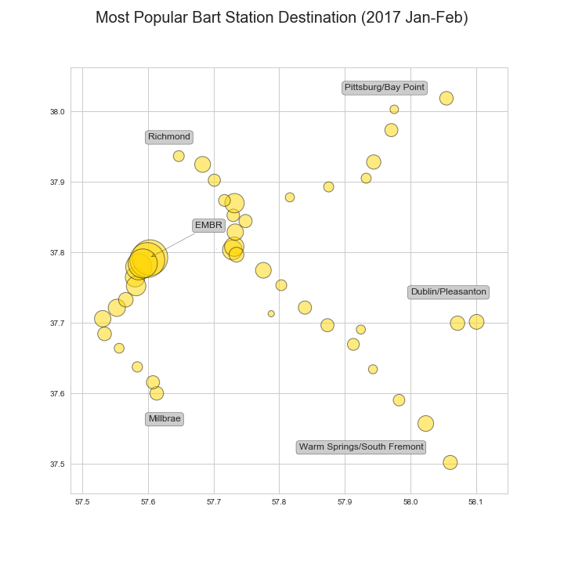
Super Bowl Impact– Destination (Jan-Feb)

Slide 5
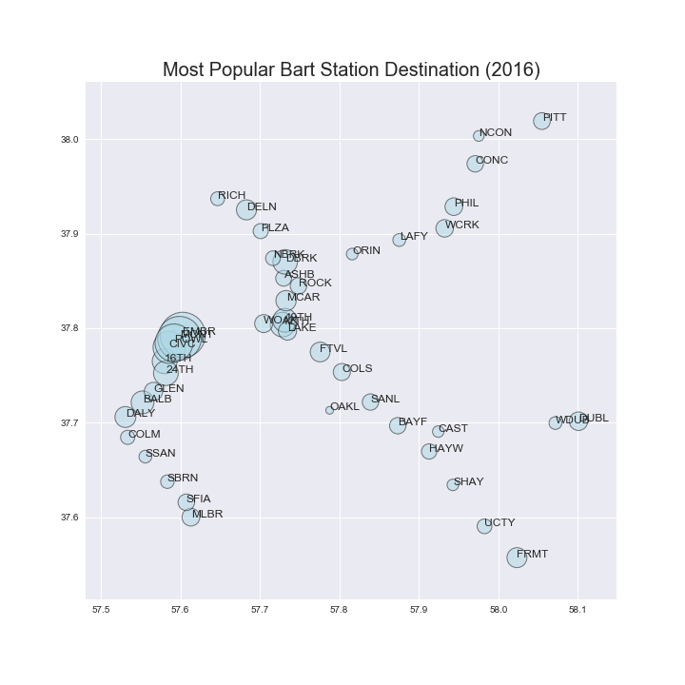
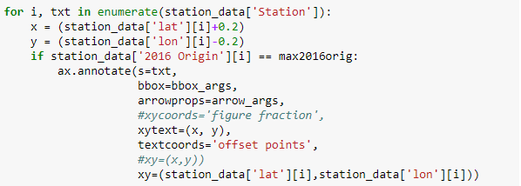
Key Learnings – Focus on Question
Original plan: add station names to all data points
Final result: add end point stations only and highlight most popular station

Slide 6
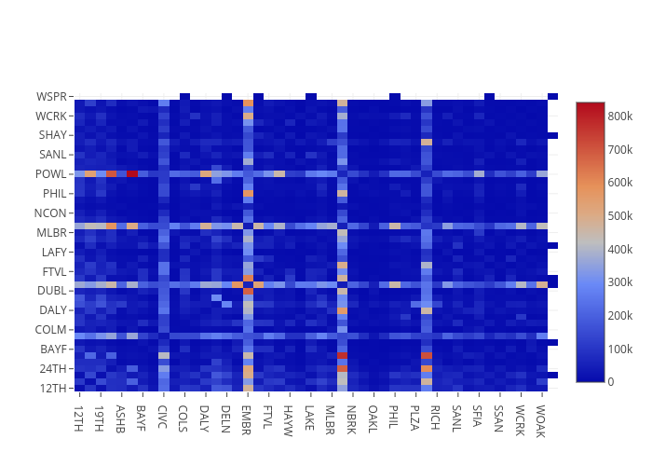
Throughput Between Stations (2016)
https://plot.ly/~tli2001/4/

Slide 7
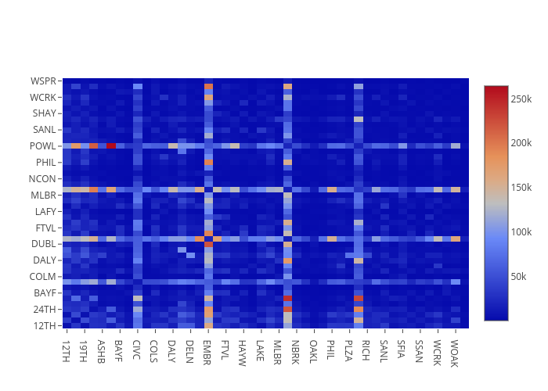
Throughput Between Stations (2017)
https://plot.ly/~tli2001/6/

Slide 8
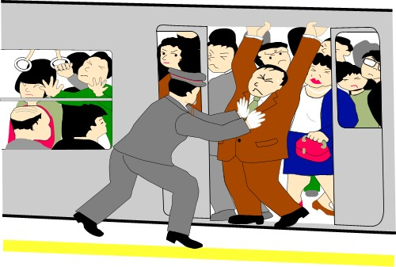

Popular Station Findings
Verdict: If you’re going to go to or through downtown San Francisco - specifically Embarcadero, Montgomery, Powell, or Civic Center, there’s a high possibility of the trains being packed due to the popularity of these stations.
Comparing 2016 to 2017, there was a noticeable overall increase in traffic during the Super Bowl, but there was no change in the popularity of stations used.

